Slide 1
COEN 359 – Design Patterns Term Project
Eat Smart Vending Machine
Kavya Gautam
Ramya Bangaluru Gopalakrishna
Swathi Damera

Slide 2
Introduction
Purpose:
To provide easy accessible healthy food products to students of schools and universities.
Basic Features
Buy an item
Check calorie/ingredient information
Ask eatSmart for suggestions
View eatSmart’s most popular items
Additional Features:
My Favorites
History
Redeem
Reload

Slide 3
Admin Features
Monitor VM,
view VM,
manage VM,
view sale statistics VM wise
Check Sales and revenue for all MS and VM under supervision,
checkout most popular items
Add a new Item
Change price of an existing item
Add nutritional information

Slide 4
Design Patterns
GOF Patterns: Non–GOF Patterns:
Creational Patterns 11. MVC
Factory Method 12. Security
Builder Pattern 13. DAO
Prototype Pattern
Singleton
Structural Patterns
Composite
Facade
Behavioral Patterns
Mediator
State
Strategy
Iterator

Slide 5
Flow of the Design patterns
file://localhost/Users/kavyagautam/Desktop/workflow_diagram.jpg

Slide 6
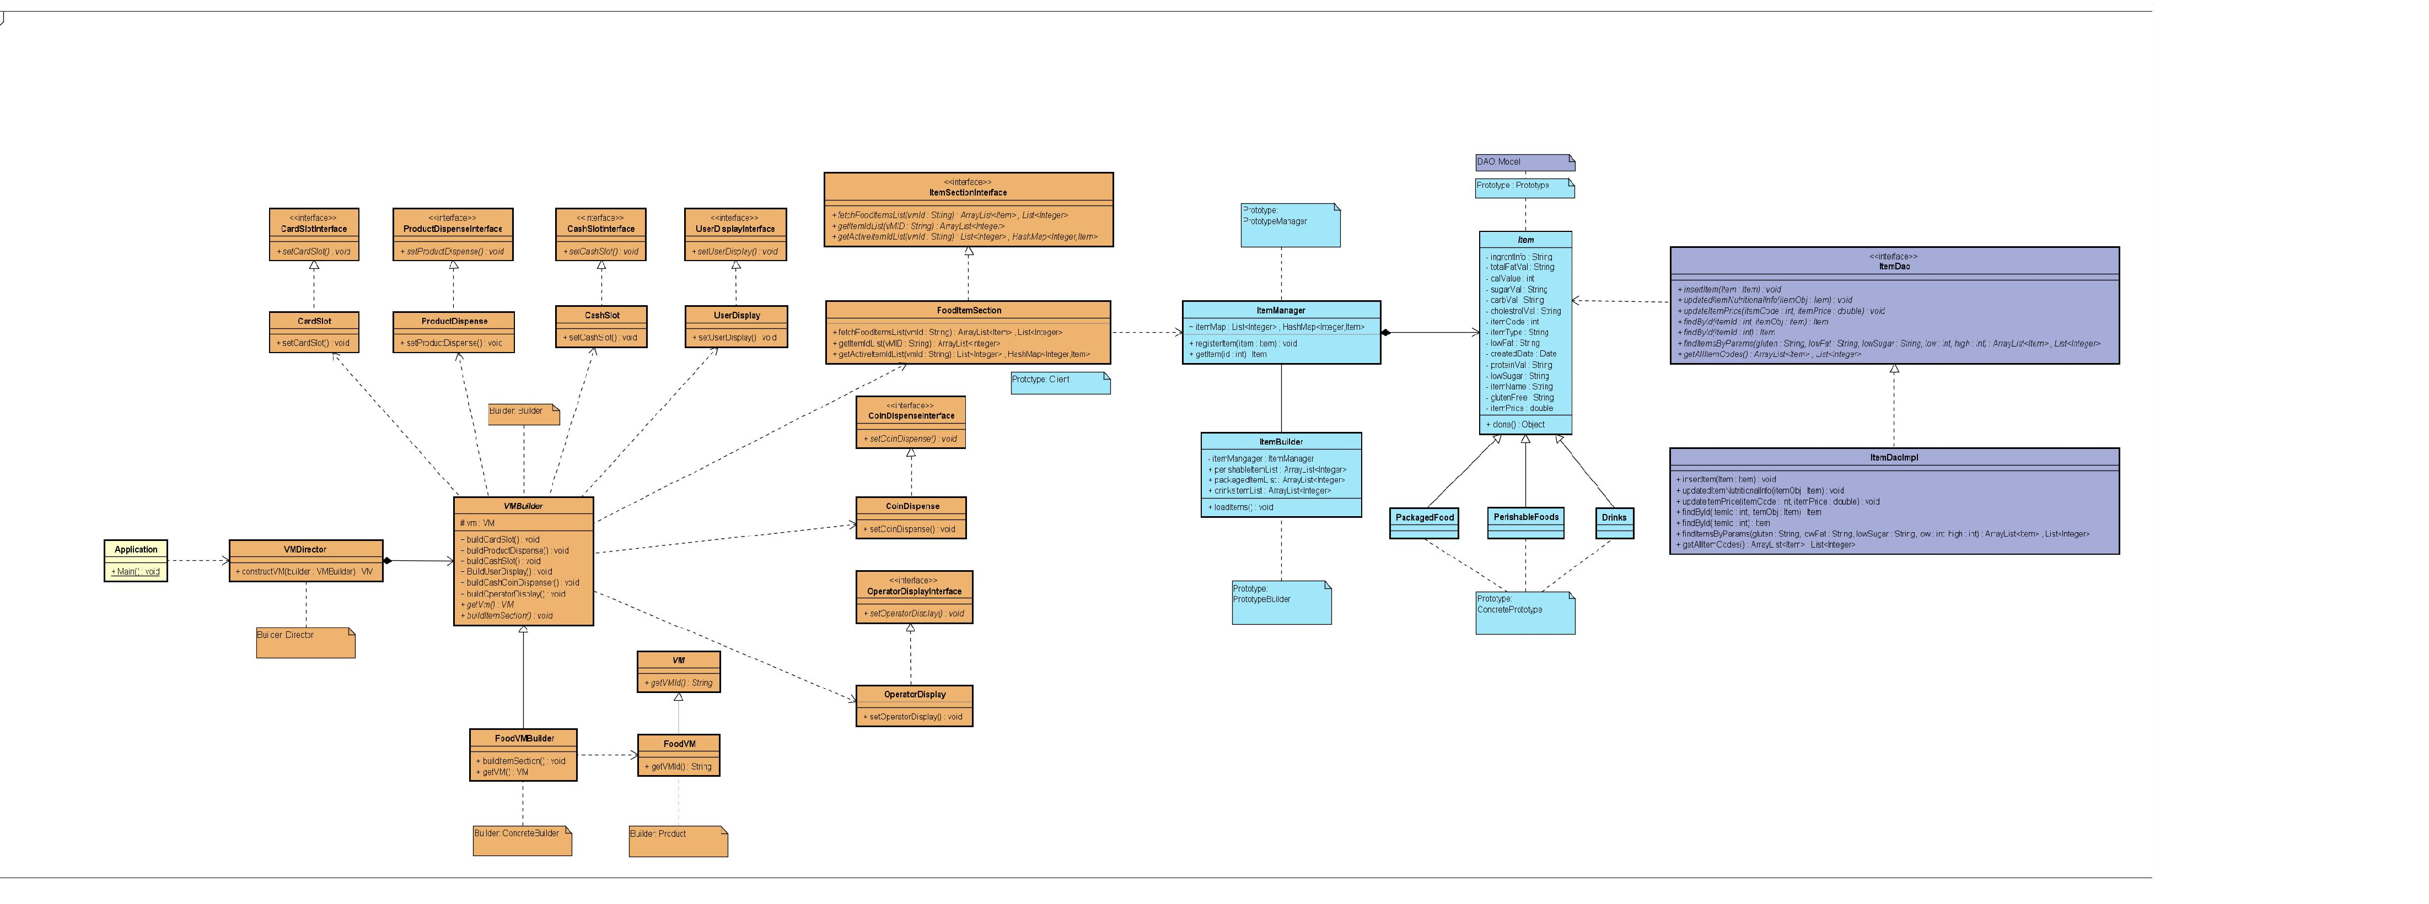
UML (Builder + Prototype Patterns) file://localhost/Users/kavyagautam/Desktop/Builder_and_prototype (1).jpg

Slide 7
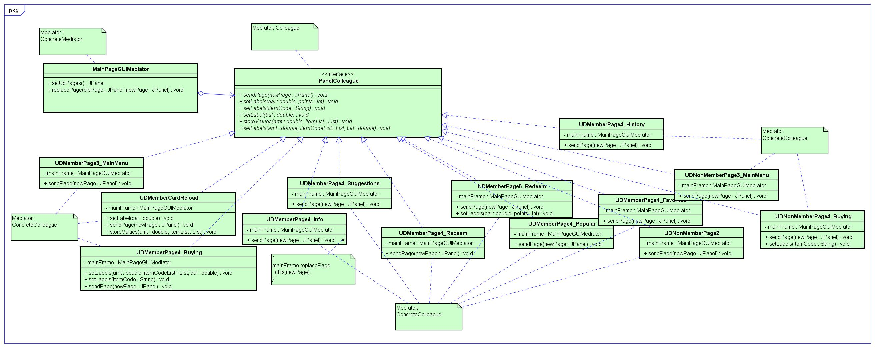
UML (Mediator + View Controller Patterns)

Slide 8
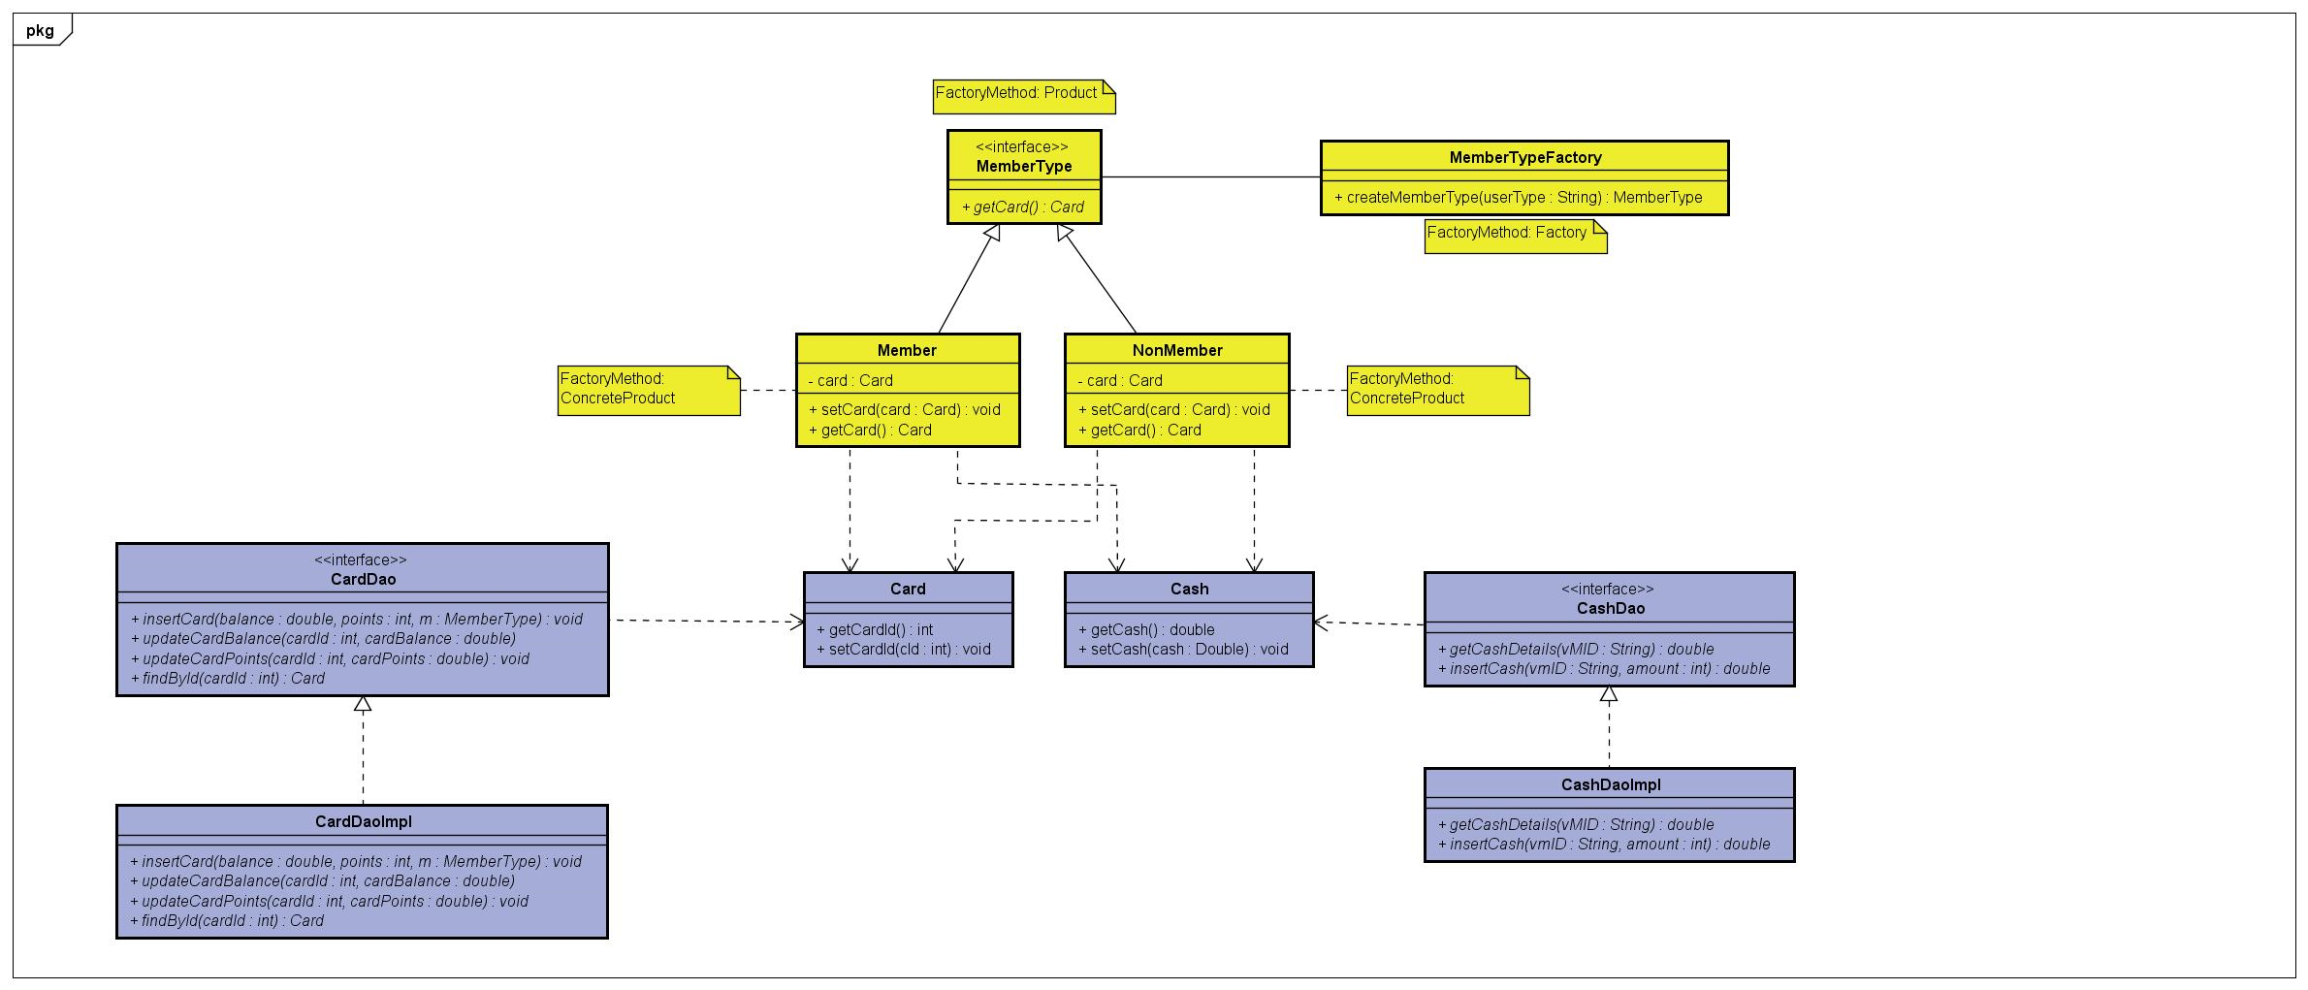
UML (Factory Method + DAO Patterns)

Slide 9
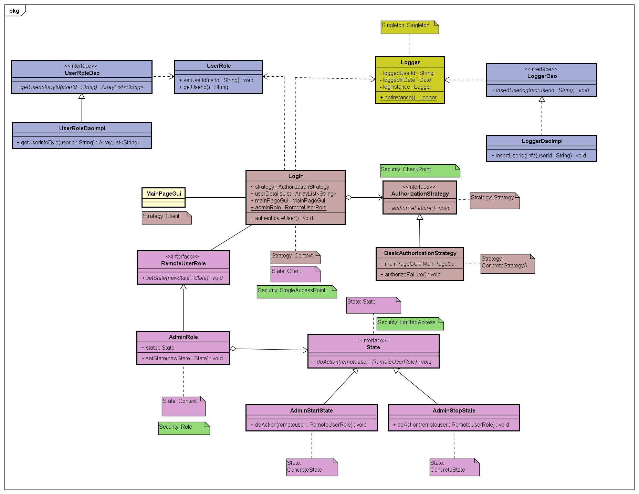
UML (Security- State, Strategy, Singleton)

Slide 10
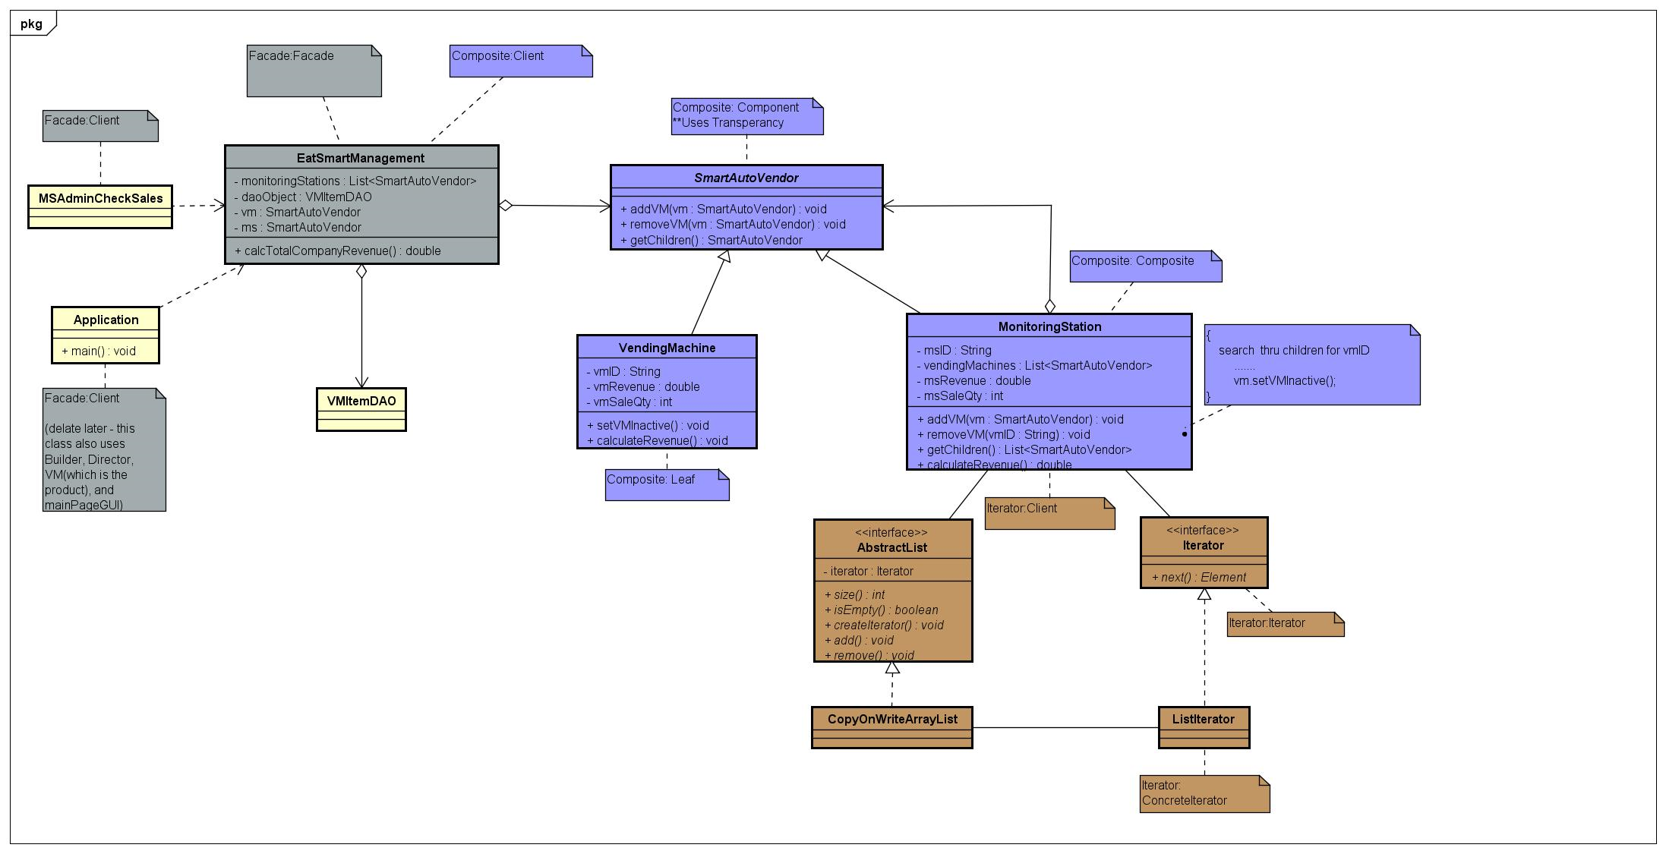
UML (Composite + Iterator + Façade Patterns)

Slide 11
Challenges
Builder - creating a common interface for the constant and variable parts was challenging
Composite - deciding on the component interface for the part-whole hierarchies was tricky
Prototype - Deciding on having generic or specific item classes was challenging

Slide 12
Future scope
Memento
Observer
Bridge Pattern implementation for Payment mode
Decorator for multithreading

Slide 13
Demo
User
Admin
Operator

Slide 14
Thank You

